Slide 1

Gary Goforth MD
Preparing to Hike the Appalachian Trail

Slide 2
The 5 W’s
What
Where
When
Who
Why

Slide 3
What Is The Appalachian Trail?
The Appalachian Trail is a continuous marked footpath that goes from Mount Katahdin in Maine to Springer Mountain in Georgia, a distance of about 2160 miles.

Slide 4
Math Question
If you walked 12 miles a day, how many days would it take you to complete the Appalachian Trail?

Slide 5
Answer
If you walked 12 miles a day, it would take you 180 days or 6 months to complete the Appalachian Trail.
15 miles/day, 5 months
18 miles/day, 4 months

Slide 6
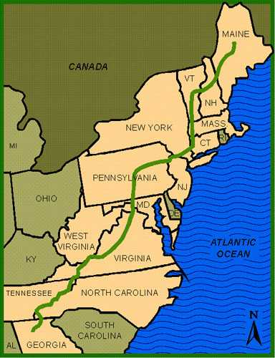
Where

Slide 7
Who & When
The Appalachian Trail was the "brainchild" of Benton MacKaye, educated as a forester, who proposed connecting thread of already existing trails.
1921 he published his idea.

Slide 8
Who & When
The Appalachian Trail Conservancy (ATC): the only nonprofit devoted exclusively to protecting, managing, and advocating for the entire Appalachian National Scenic Trail
Headquarters in Harpers Ferry, West Virginia

Slide 9
Who & When
At the summation of the two-day meeting on March 3, 1925, at the Grand Raleigh Hotel in Washington, DC the Appalachian Trail Conference (later renamed Conservancy) was established to realize a dream – a continuous footpath, from Georgia to Maine.
Celebrating the 100-Year Anniversary in 2025

Slide 10
Who & When
On August 14, 1937, the Appalachian Trail became a reality.
1938, however, the trail was no longer continuous. A hurricane destroyed much of it in New England.
The first person to walk the whole trail or do a “thru hike” was Earl Shaffer.

Slide 11
Who and When
National Trails System Act, adopted late in 1968, made for a series of "national scenic trails" within the national park and forest systems.
The Appalachian Trail was the first trail to fall under this Act.

Slide 12
How Many????
Since 1936, 7,830 hike completions have been recorded by ATC.
2,000-milers by Decade
1930-1939 8
1940-1949 3
1950-1959 13
1960-1969 37
1970-1979 740
1980-1989 1,402
1990-1999 3,241
2000-present 2,361+
Approximately 25% of hikers intending to be thru-hikers complete the entire hike.

Slide 13
Why for me?
Lifelong dream since doing several 50-mile hikes with Boy Scouts in East Tennessee
A major long-term goal in my quest to become healthier in 2018
A dream which seemed possible after hiking two strenuous AT sections – White Mountains Presidential Range in New Hampshire and 42-mile route from Amicolola Falls to Neel’s Gap, Georgia

Slide 14
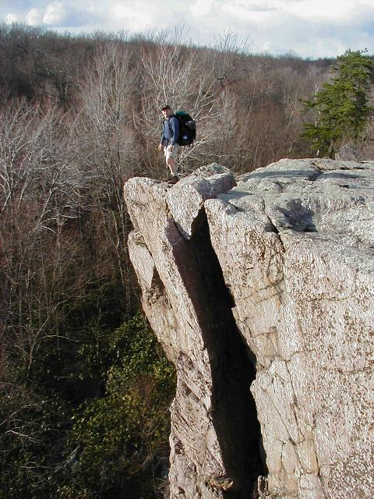
Why

Slide 15
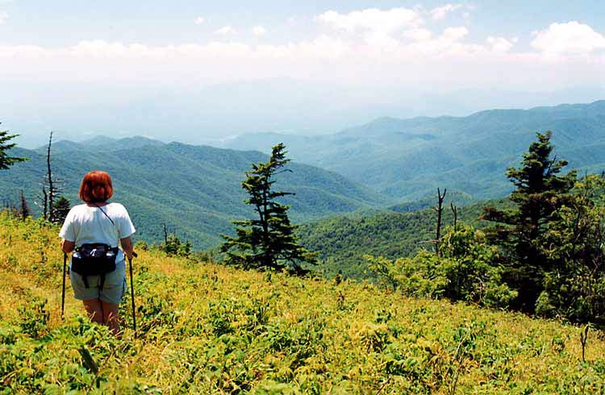

Slide 16
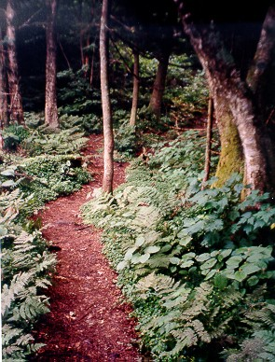

Slide 17
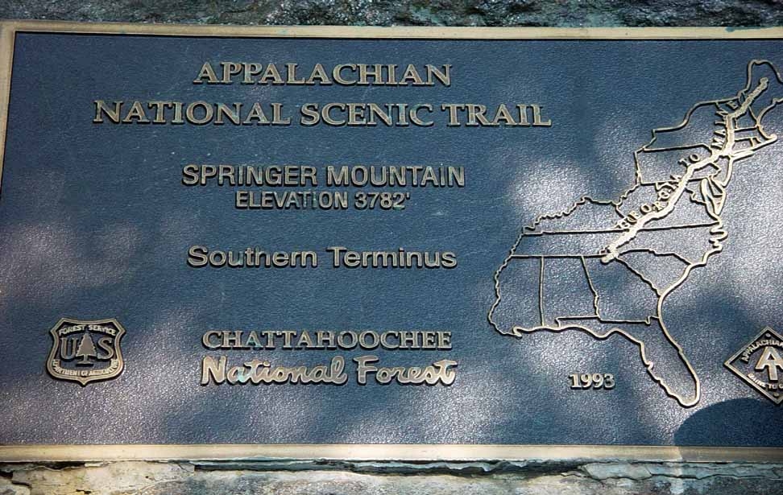

Slide 18
How have I prepared for AT Thru-Hike?
Daily exercise (15-20,000 steps/day)
F3 fitness group 3 days/week
Cycling 100 miles/week; Ft. Myers-Key West Bike Ride
Backpacking with 30-pound pack weekly
Two major shake-down hikes to White Mountains and southern 42-miles of AT
Lots of reading of books, articles, AT Facebook site and movies about AT

Slide 19
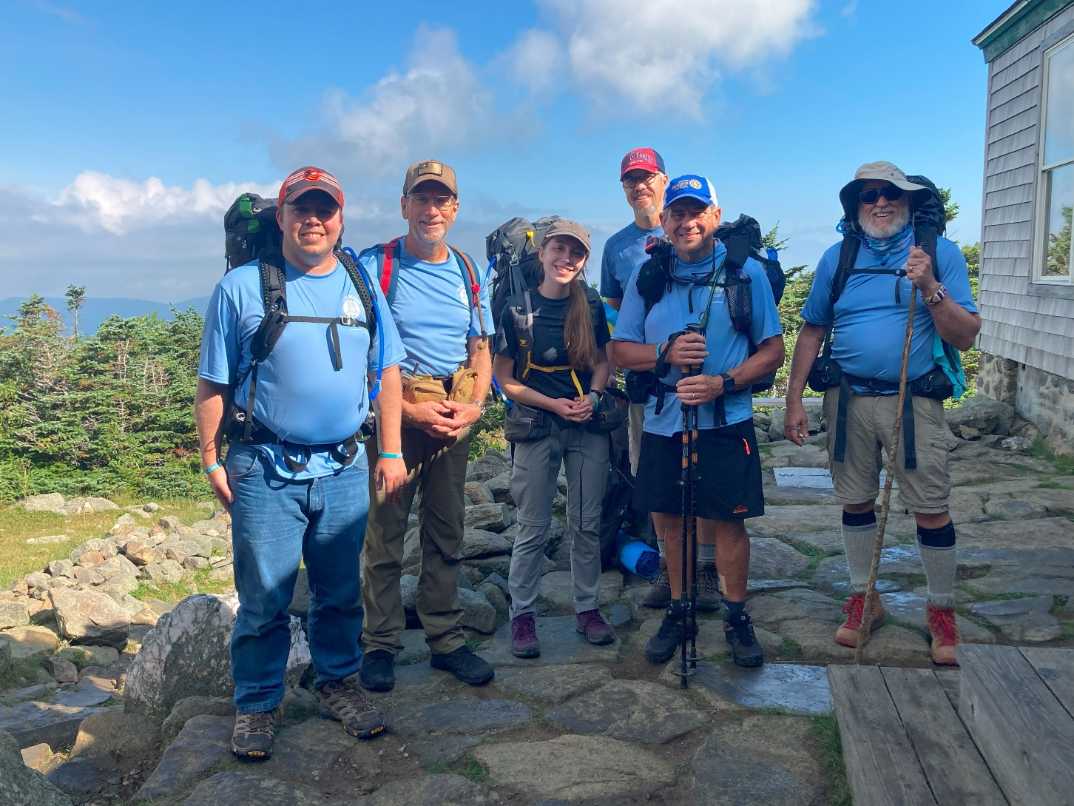
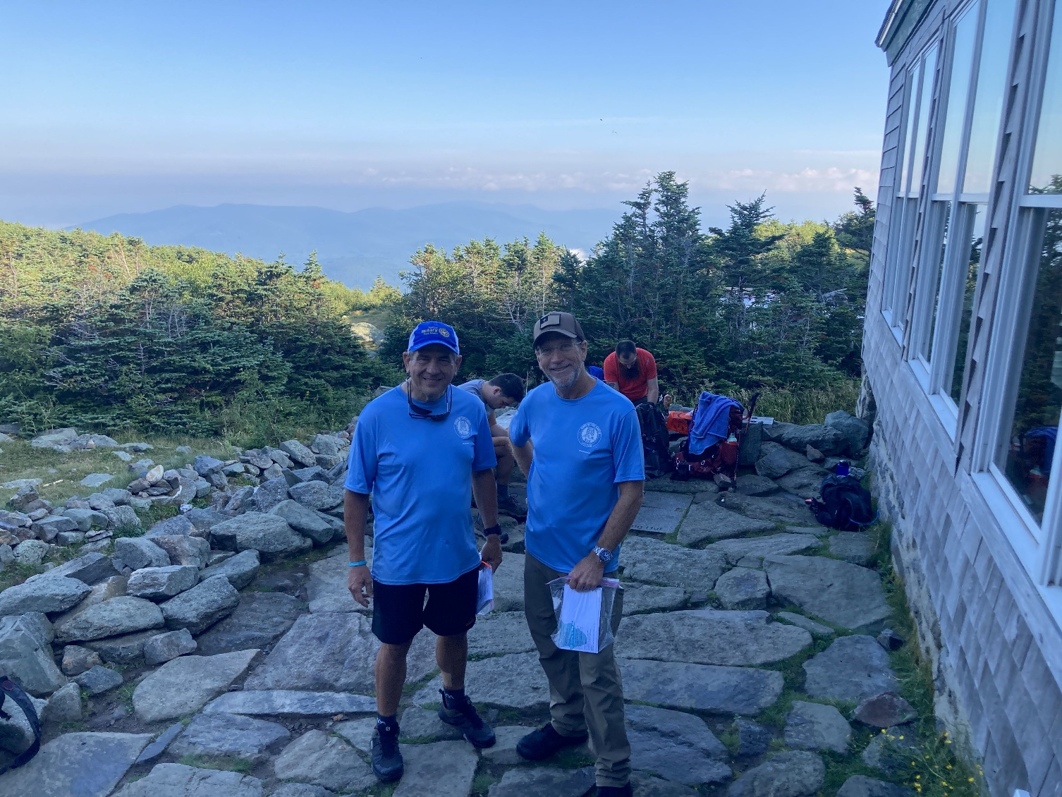
White Mountains: Presidential Range

Slide 20
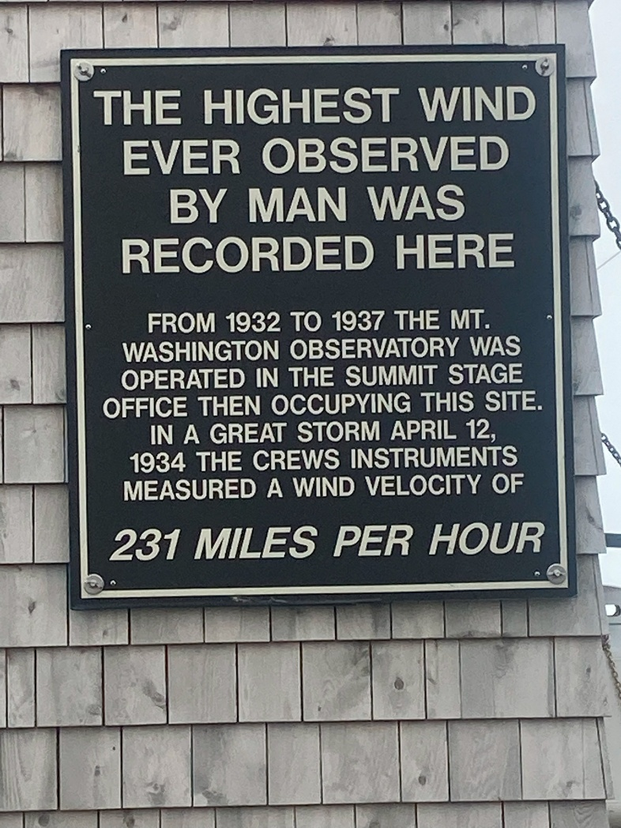
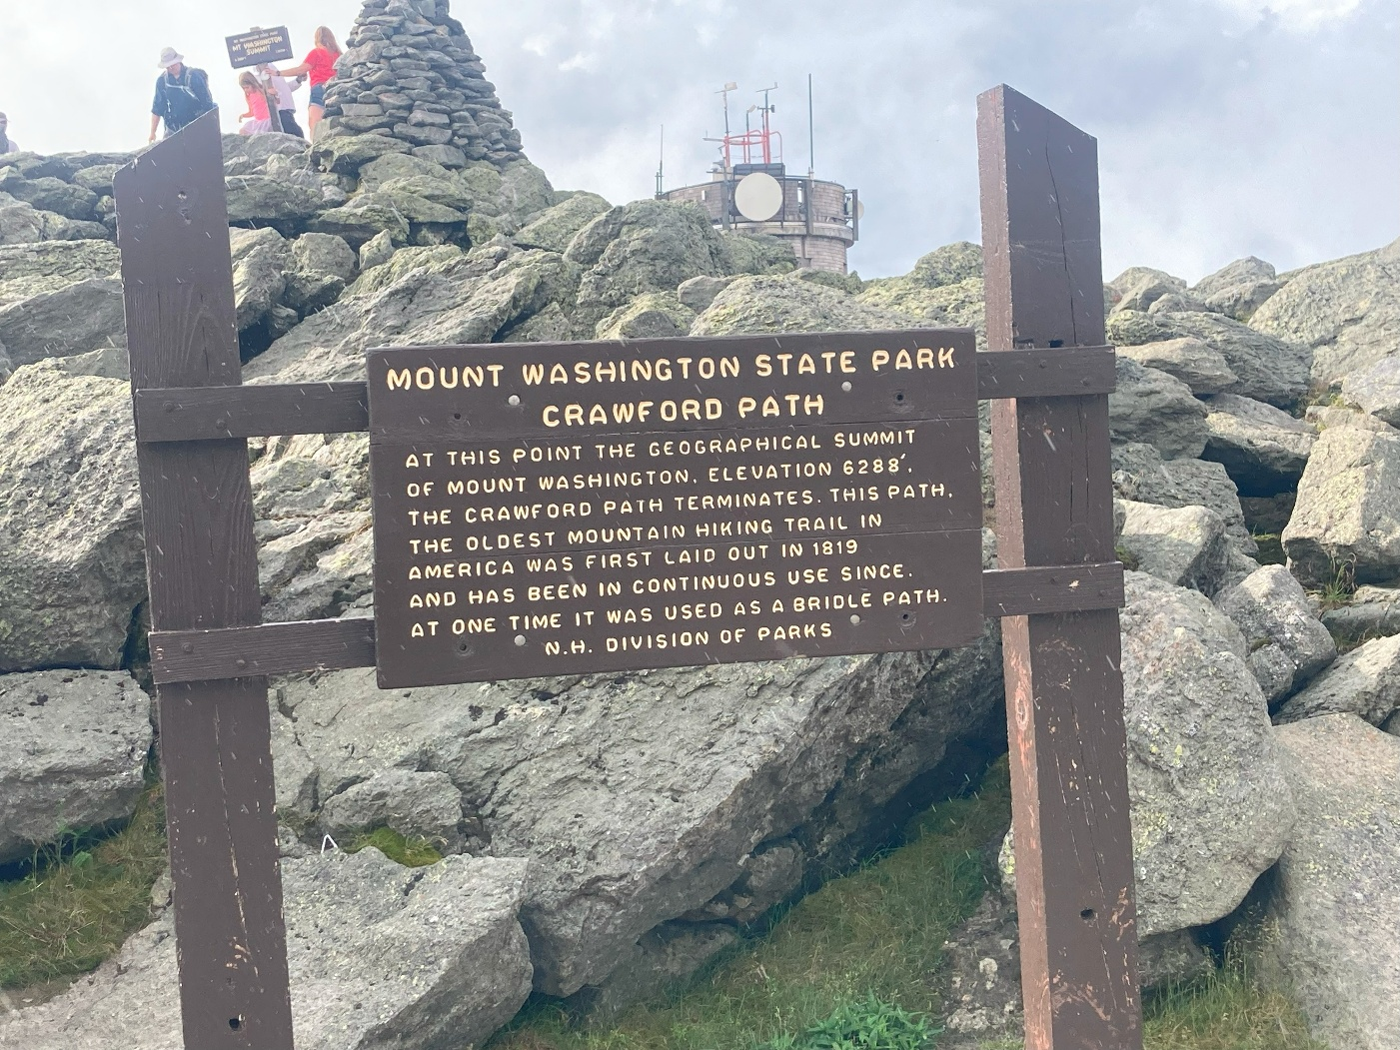
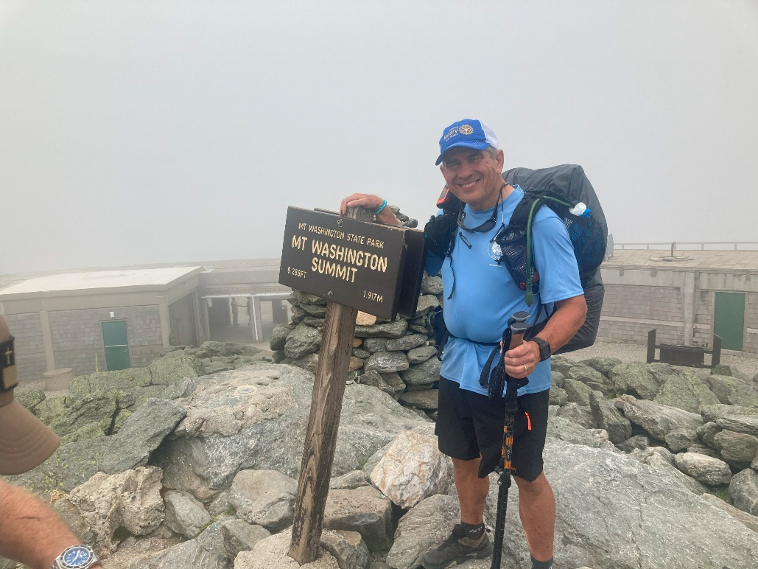
White Mountains: Mount Washington

Slide 21
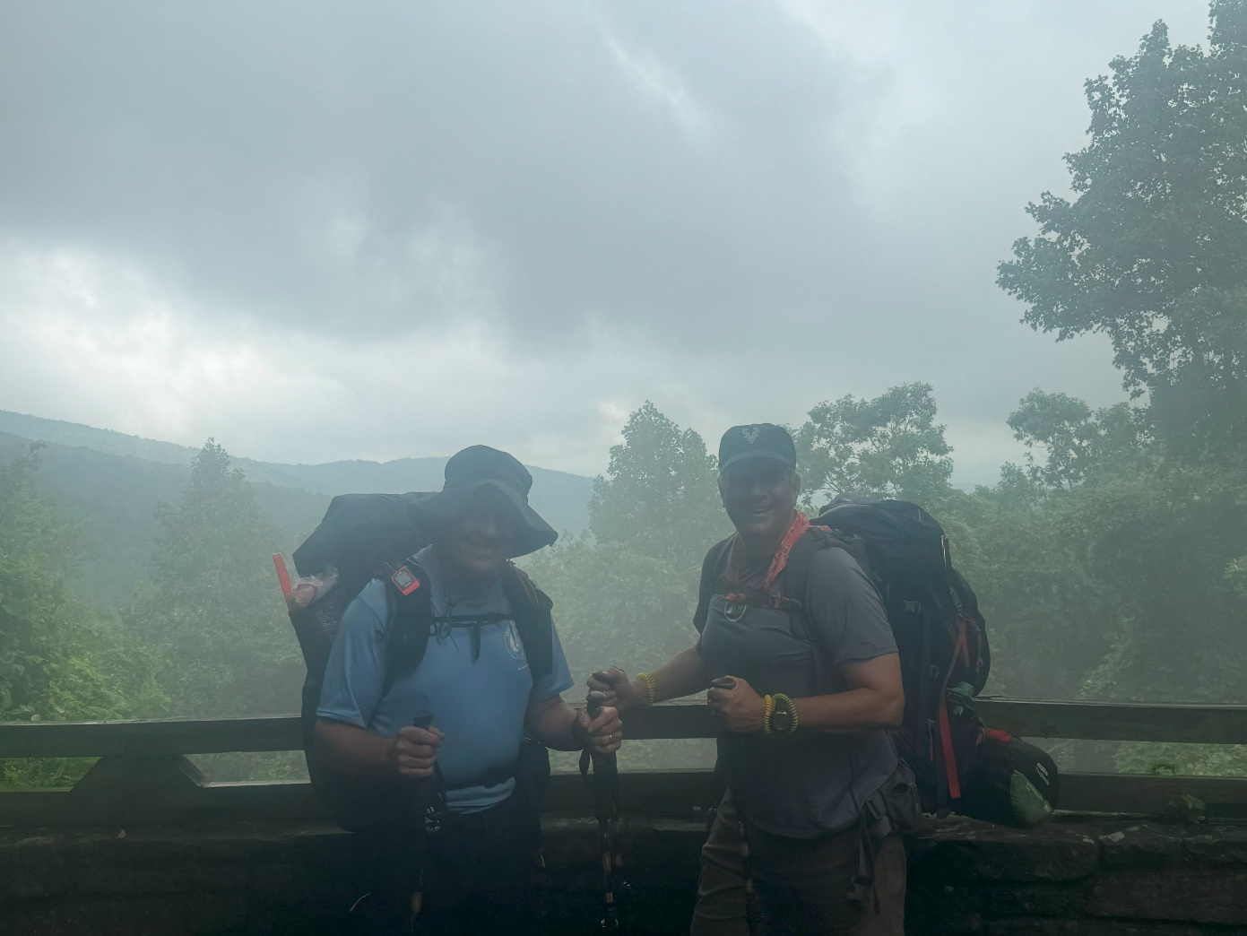
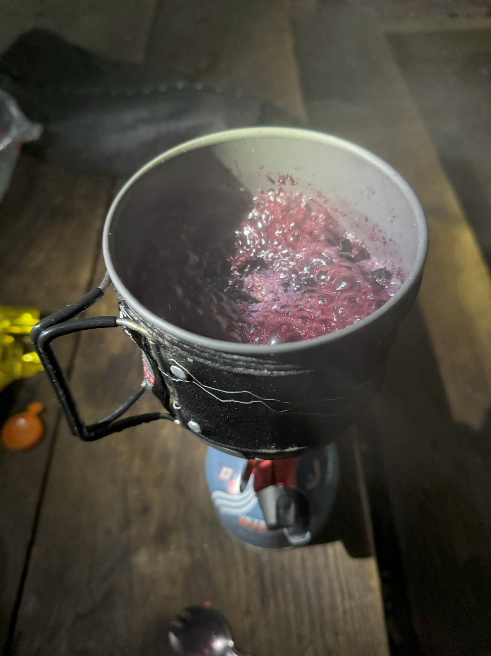

Shake-down hike:
Amicolola Falls to Neel’s Gap, GA

Slide 22
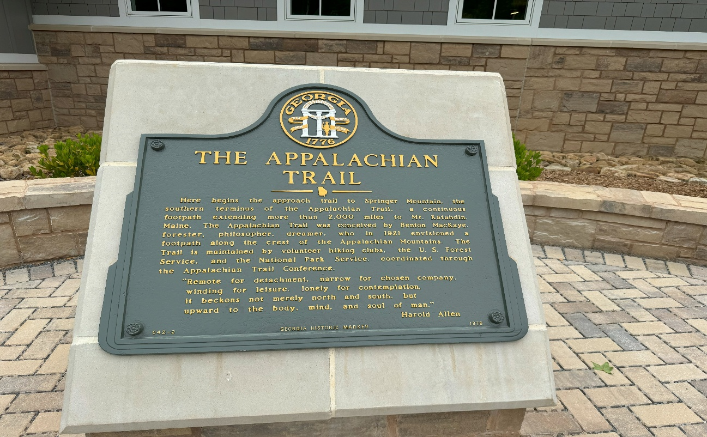
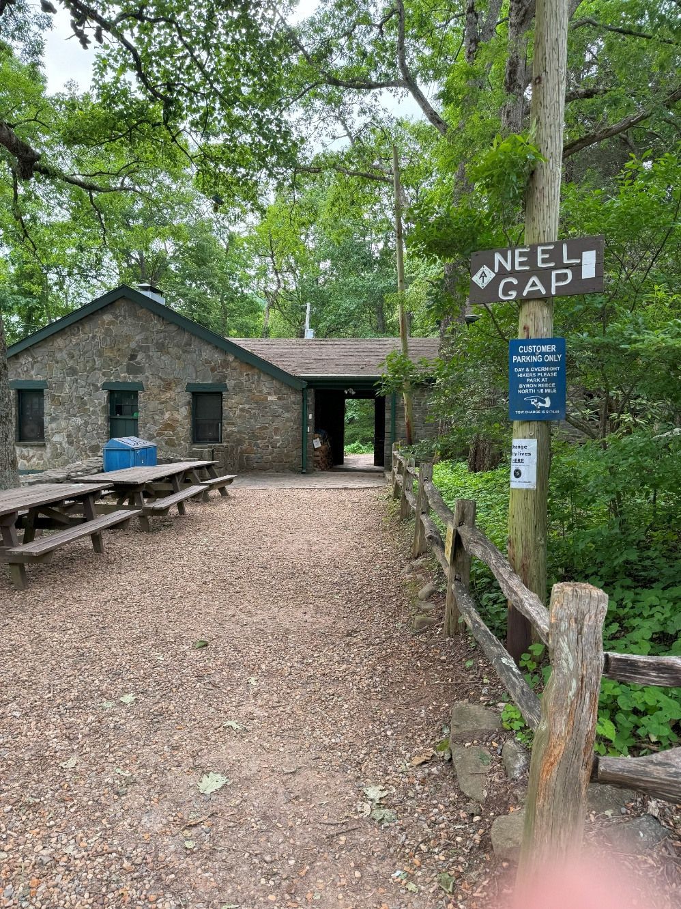
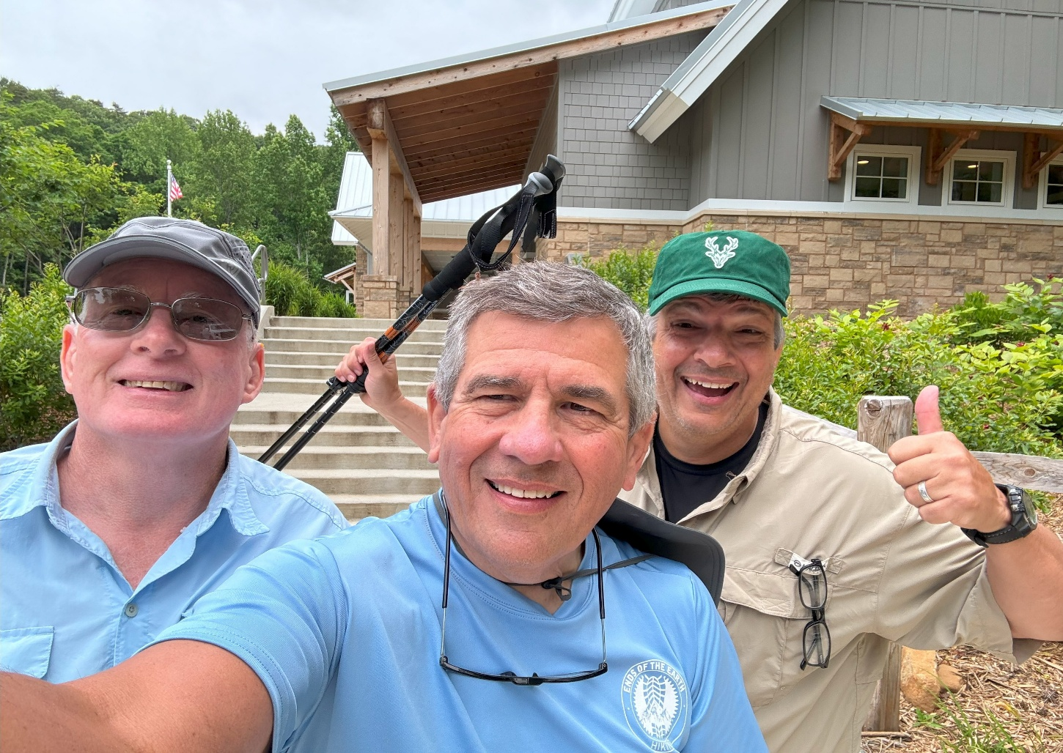
Shake-down hike:
Amicolola Falls to Neel’s Gap, GA

Slide 23
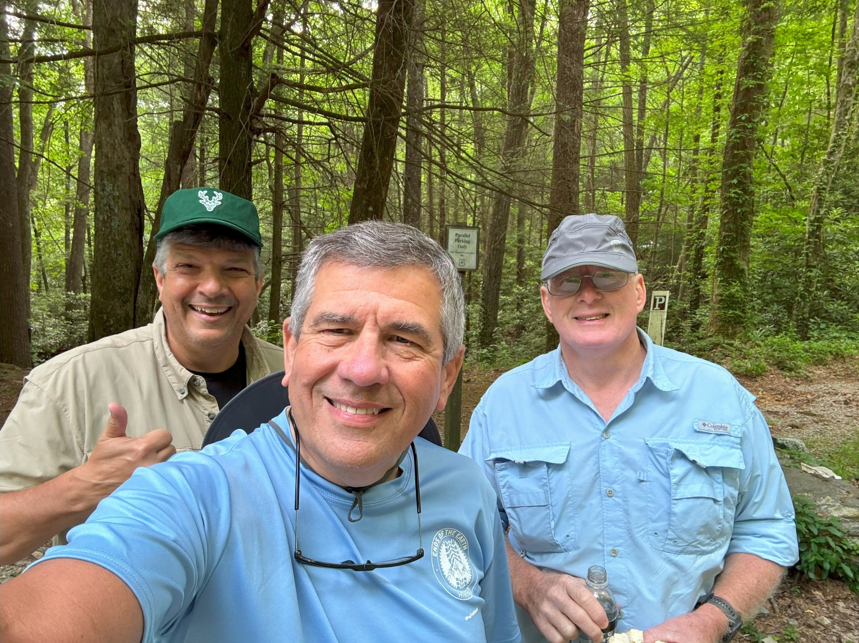
Shake-down hike:
Amicolola Falls to Neel’s Gap, GA

Slide 24
Fun Facts About the AT
Which state on the AT are you most likely to see bears?
New Jersey

Slide 25
Fun Facts About the AT
What kind of tape is a must for hiking the AT?
Duct Tape

Slide 26
Fun Facts About the AT
What is the biggest threat on the AT?
Ticks

Slide 27
Fun Facts About the AT
The elevation gain/loss on the AT is like climbing Mt. Everest how many times?
16

Slide 28
Fun Facts About the AT
What are the 3 major hiking trails in the US?
Continental Divide, Pacific Crest, and Appalachian Trails

Slide 29
Fun Facts About the AT
Which of these major trails is the most difficult?
Appalachian Trail

Slide 30
Fun Facts About the AT
What is a trail angel?
Someone who helps a hiker

Slide 31
Fun Facts About the AT
How many shelters are located on the AT?
262 (every 8 miles on average)

Slide 32
Fun Facts About the AT
Which direction do the majority of thru-hikes go?
Northbound or NOBO (88%)

Slide 33
Fun Facts About the AT
What is the average body weight an AT thru-hiker loses when doing an entire thru-hike?
30 pounds

Slide 34
Fun Facts About the AT
What type of food is used most often by thru-hikers?
Freeze-dried food

Slide 35
Fun Facts About the AT
How often do thru-hikers need to resupply (food, supplies, charging packs)?
Every 4-5 days (except 10 days in 100-mile Wilderness in Maine)

Slide 36
Fun Facts About the AT
How do thru-hikers obtain clean water?
Micropore filter (e.g. Sawyer Squeeze), boiling water, water purification tabs

Slide 37
Fun Facts About the AT
How and where do thru-hikers sleep?
Majority outside shelters in tent or hammock

Slide 38
Fun Facts About the AT
How do you prevent bears and other animals from eating hikers’ food?
Ursack Almitey bear bag, PCT bear hang, steel boxes in some shelters

Slide 39
Fun Facts About the AT
How many calories per day does the average thru-hiker burn?
5,000 calories

Slide 40
Fun Facts About the AT
How do hikers protect themselves from large animals and dangerous people?
Bear pepper spray, pistol (cannot be carried in national parks)

Slide 41
Fun Facts About the AT
How do hikers find their way on the AT?
Follow white, rectangular trail markers on trees; FarOut app, AT Guide

Slide 42
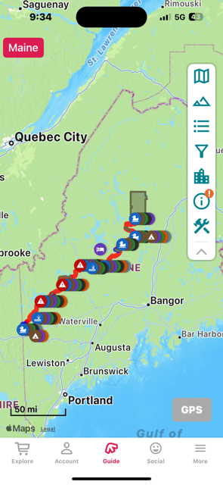
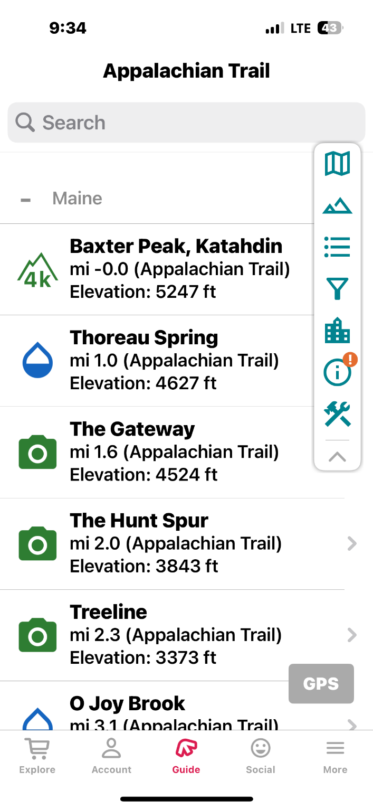
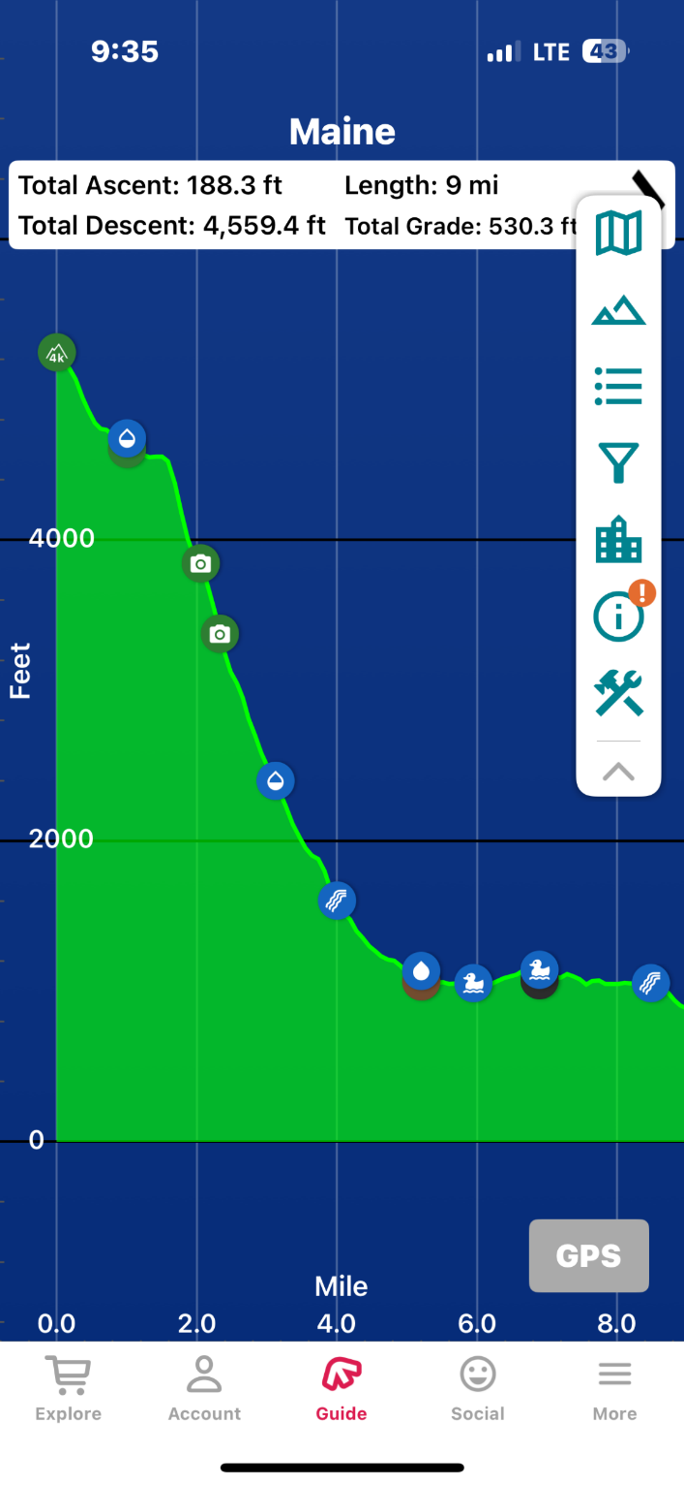
Far Out App

Slide 43
Fun Facts About the AT
What happens if there is a major emergency?
Activate SOS on Garmin In-Reach device (uses Iridium satellite network)

Slide 44
Fun Facts About the AT
How do hikers communicate with family and friends?
Smart phones (Verizon best coverage), Satellite devices (Garmin InReach), FaceBook, Blogs

Slide 45
QUESTIONS?

